Slide 1


Introduction Data Management Planning
Joy Davidson
Digital Curation Centre

Slide 2
What is a DMP?
A short plan that outlines
what data you will create and how
how you will manage it
(storage, back-up, access…)
plans for data sharing and preservation
DMPs are often submitted as part of grant applications, but are useful whenever you’re creating data.
Create
Document
Use
Share
Preserve
Store

Slide 3
Why develop a DMP?
to help you plan to share your data appropriately
to anticipate and avoid problems e.g. data loss
to comply with funders requirements...
to provide guidelines for everyone working on the project

Slide 4
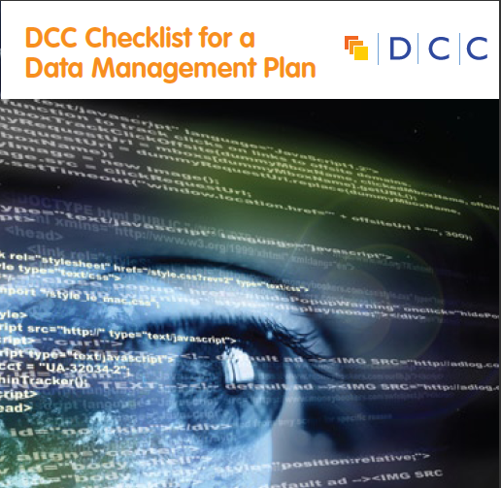
They typically want a short (c.1-2pp) statement covering:
  What data will be created (format, types, volume...)
  Standards and methodologies to be used (incl. metadata)
  How ethics and Intellectual Property will be addressed
  Plans for data sharing and access
  Strategy for long-term preservation

Slide 5


Data sharing plan
Covering:
Dataset
Standards
Metadata
Preservation
Data sharing
  method
  timescale
  restrictions
  agreements
Data Mgmt Plan
Covering:
Data
Data sharing
  when?
  where?
  how?
  restrictions?
Preservation
Resources
Data Mgmt Plan
Covering:
Data
Data collection
Management
Security
Data sharing
Responsibilities
Related policies
Admin details

Slide 6

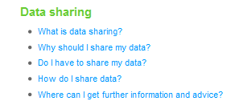
Some funders don’t ask for a DMP but still have expectations
Researchers applying for an HTA grant should consider data sharing in their proposals
Don’t prescribe sharing but expect researchers to consider and plan for it as appropriate
Follow DOH Research Governance Framework and MRC guidelines for Good Research Practice
www.hta.ac.uk/funding/troubleshooting/index.html
Notes:
In the FAQs for the Health Technology Assessment Programme, NHS clarifies that...

Slide 7
Tips for writing DMPs
  Start early - don’t wait until the last minute to plan!
  Don’t write the plan in isolation - seek advice from colleagues, ethics, IT, library, DP/FoI...
  Be realistic - base plans on available skills & support
  The plan will - and should - change over life of project
  Use plan as a communication tool with partners, funders and yourself!

Slide 8

Thanks – any questions?
DCC guidance, tools and case studies:
www.dcc.ac.uk/resources
Follow us on twitter:
@digitalcuration and #ukdcc

